Slide 1
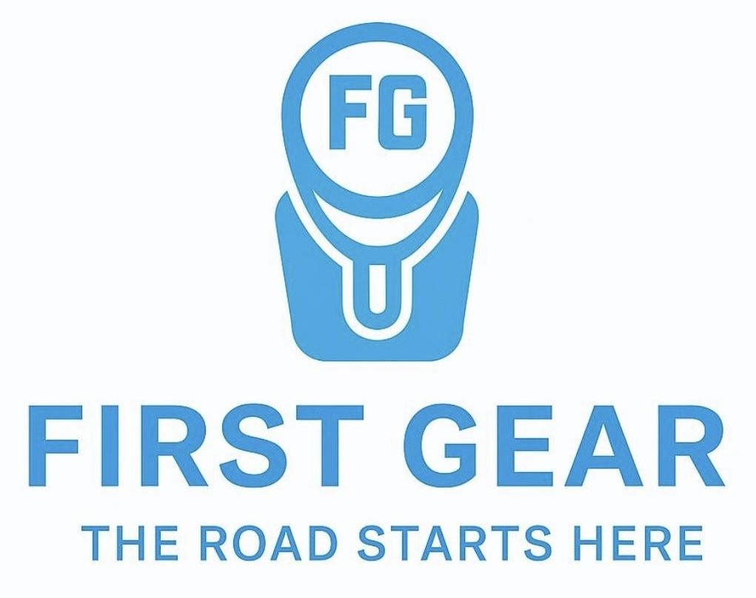
First Gear Motor Group
The UK’s First Dedicated First Time Driver Platform
Retailing qualifying dealer part exchanges under a trusted, specialist brand.

Slide 2
The Opportunity
A Structurally Underserved Segment
700,000+ new drivers in the UK annually
Significant proportion purchase vehicles under £5,000
First year insurance premiums often £2,000-£3,500+
Sub £5,000 segment estimated £3.5bn-£5.9bn annually
No national brand dedicated exclusively to first time drivers
Demand exists. Supply exists.
They are not efficiently connected.

Slide 3
The Problem for Dealers
Low Value Part Exchanges are Inefficient
Low auction returns and high fees
Admin time spent on low value retail stock
Lost workshop utilisation
Missed customer lifetime value
Dealers send value to auction that could be retained.

Slide 4
The First Gear Solution
A Zero Risk, Zero Admin Retail Partnership Model
The Process:
Dealer flags qualifying part exchange
First Gear agrees guaranteed return
Dealer completes prep (funded by First Gear)
First Gear handles marketing, sale & handover
Dealer receives guaranteed return + workshop revenue
Sales risk sits with First Gear, not the dealer.

Slide 5
The Problem for
First Time Drivers
Buying a First Car is Overwhelming and High Risk
Limited budget
High insurance premiums
Lack of trust in private sellers
No structured guidance
Young drivers are left navigating one of their biggest financial decisions alone.

Slide 6
The First Gear Solution
The Nationwide One Stop Shop
HPI clear vehicles within strict criteria
Specialist insurance partnership
Warranty options
Driving school network referrals
Trusted, structured buying process
Everything in one place on a nationwide platform.

Slide 7
Example Deal Economics
Retail price: £2,000 Auction estimated return: £500 First Gear guaranteed return: £1,000 Preparation budget: £300
Dealer outcome: +£500 uplift vs auction +£300 workshop revenue
First Gear outcome: £700 gross margin Insurance referral Warranty referral Finance referral

Slide 8
Competitive Advantage
Niche positioning as first time driver specialist
Zero risk dealer partnership model
Capital light structure
Embedded insurance/warranty potential
Scalable via regional dealer network
Designed to become the trusted first point of contact for new drivers nationwide.

Slide 9
Growth Strategy
Phase 1:
Regional dealer partnerships
Nationwide driving school partnerships
Specialist insurance partner
Phase 2:
Nationwide dealer partnerships
National brand recognition
Insurance & Finance partnerships
Increased stock flow
Phase 3:
The one stop shop
Dedicated sales & logistics support

Slide 10
Why This May Be Relevant
Access to first time driver segment at point of entry
High margin insurance & warranty opportunity
Capital light retail structure
Opportunity for embedded distribution partnerships
Scalable distribution model
Open to strategic dialogue around insurance, warranty and future capital alignment.

